Slide 1
Psychometrics Lecture 4
Principal Component Analysis
Reading materials:
- Workbook text on PCA
- (chapter 12 of Furr book)

Slide 2
Principal Component Analysis
Connection with previous topics:
Week 1: PCA is a scaling technique.
Week 2: PCA creates optimally reliable aggregates of item scores.
Week 3: PCA assesses internal structure.

Slide 3
Principal Component Analysis
Problem and aim: We have a very great number of correlated variables, that we want to summarize as well as possible by a smaller number of uncorrelated variables.
What is ‘as well as possible’?
So that each summary/component/dimension explains as much variation in the variables (in this course: item scores) as possible.
What is a ‘great number’?
Any number of variables that would be difficult to analyze or theorize about. Can be 10, a 100, a 10,000 or a billion.
What is a ‘smaller number’?
This course: Any number of variables we can theorize about. E.g., 1-5.

Slide 4
Principal Component Analysis
PCA is an exploratory data analytic technique
Completely data-driven. Cannot use or statistically test prior knowledge about associations between variables.
Prior knowledge can be used and tested with confirmatory factor analysis (next week!)
PCA is widely used in statistics, machine learning and artificial intelligence (especially for ‘big data’). Examples:

Slide 5
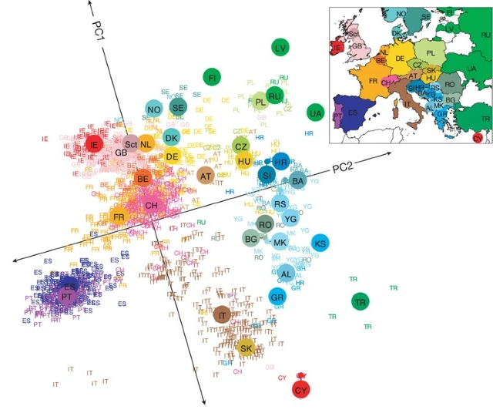
Modeling genetic variability

Slide 6
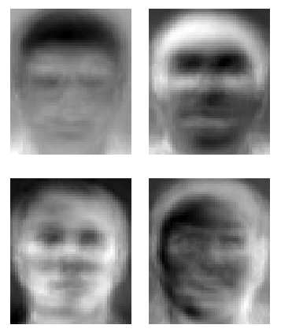

Face recognition

Slide 7
PCA in Psychological Assessment
Principal Component Analysis (PCA) and Factor Analyis (FA) are not part of classical test theory
But their history is closely related to the history of psychological tests:
intelligence tests
personality tests
...

Slide 8
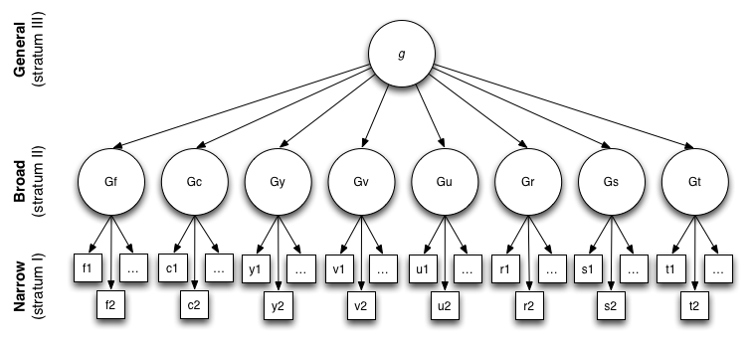
Cognitive ability (Carroll, 1993)
Model assumes latent constructs cause observed item / subscale responses (FA)
Constructs we are interested in (for scientific theory building, decision making in practice, ....)
Observed item of subscale scores

Slide 9
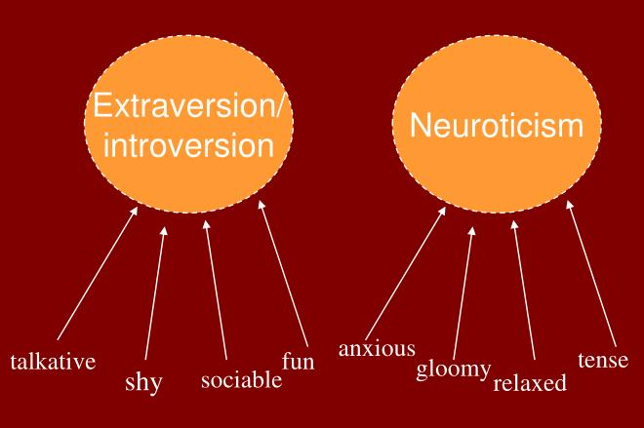
Personality
Model assumes latent constructs are caused by observed item responses (PCA)
Constructs we are interested in (for scientific theory building, decision making in practice, ....)
Observed item or subscale scores

Slide 10
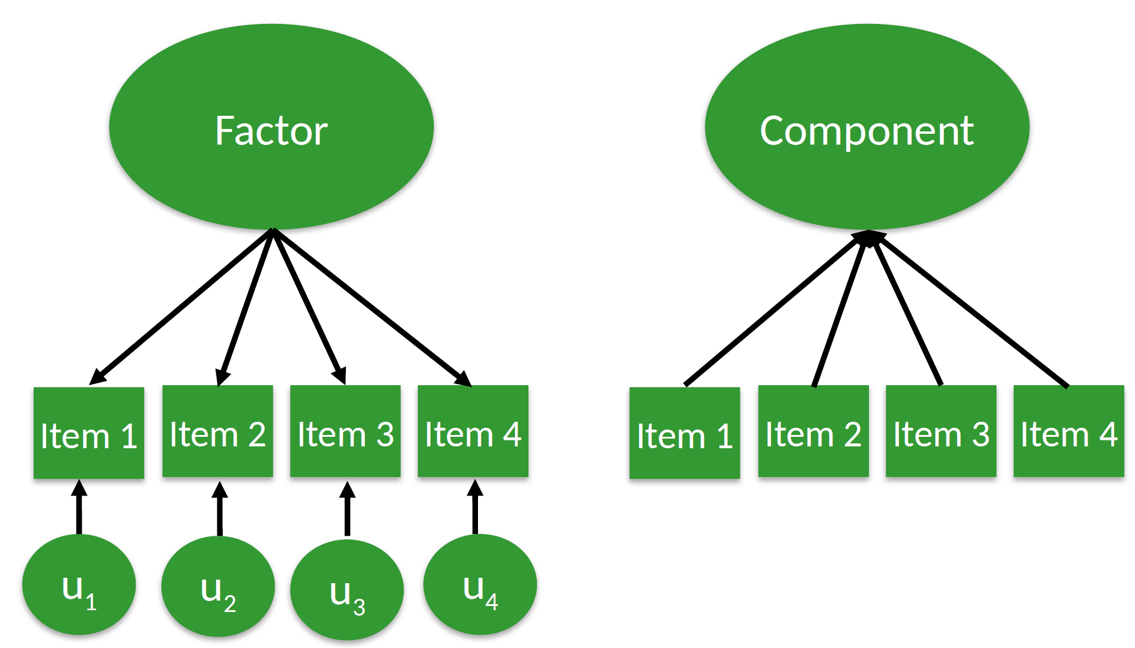
Factor analysis (FA) versus PCA

Slide 11
Principal components: Algebraic view
A principal component C_{j} is a linear combination of variables X₁ to X_{p}:
C_{j} = a_{1j} X₁ + a_{2j} X₂ + ... + a_{pj} X_{p}
The weights a_{ij} are estimated so that:
The first component C₁ explains as much variance in X₁ to X_{p} as possible
each subsequent component C₂ to C_{p} explains as much variance as possible and
is completely uncorrelated (orthogonal) to earlier components.
C₁
a₁₁ a₂₁ a₃₁ a₄₁
X1
X2
X3
X4

Slide 12

Principal components: Geometric view
Variables: Directions (axes) in p-dimensional space.
Cases (respondents): Points in this space.
Components: Directions in p-dimensional space.
First component is direction in which the points have maximum variation: i.e., the longest axis of ellipse.
Second component: direction in which point have maximum variation, orthogonal to the first direction (90º angle): i.e., the next longest axis of the ellipse.
Components form new system of axes for very same cloud of points.
X₂
X₁

Slide 13
Reducing the number of dimensions
If as many components as variables are retained, dimensionality is not reduced
The original variables are not really summarized then, so interpretability is not improved.
(this can still be very useful though, because the components are completely independent, but not for the purposes of this course)
Summarizing always loses a bit of information, but hopefully we retain as much information as possible (we quantify this by ‘% of variance explained’)

Slide 14
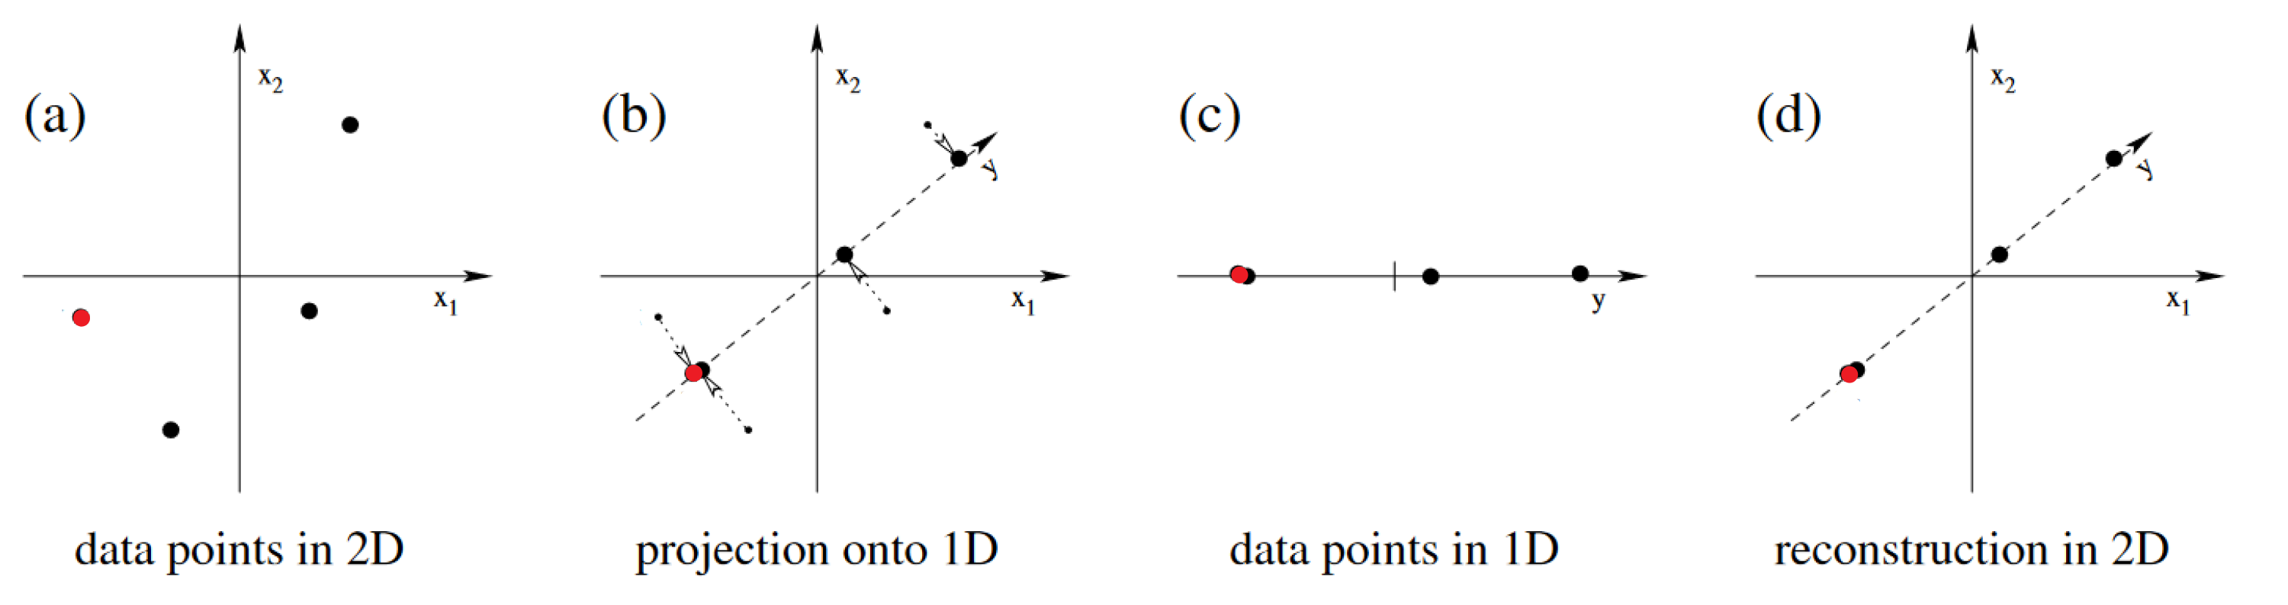
Reducing 2 to 1 dimensions
X₁ is an item on feeling sad, X₂ is an item on rumination.
How well can we describe variation in the original variables (original two axes at 90-degree angle) using only the component (new single dotted axis)?
Notes:
Two variables: x1 is an item on feeling sad, x2 is an item on rumination.
We have 4 respondents. Let’s call the two left-most points Jack (red dot) and Jill (black dot). In the original variable space (the 2 axes), we see that they differ

Slide 15
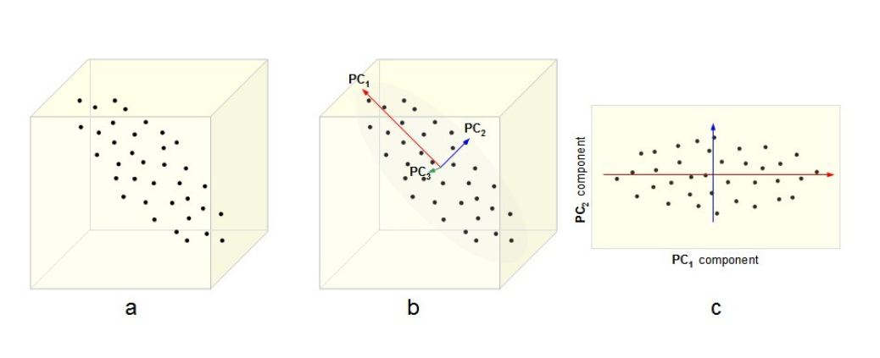
Reducing 3 to 2 dimensions
Note: Direction of projection (rotation) matters!

Slide 16

Reducing 3 to 2 dimensions
Note: Direction of projection (rotation) matters!

Slide 17
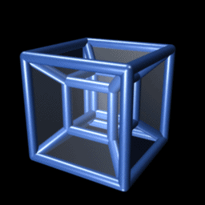
Reducing 4 to 2 dimensions

Slide 18
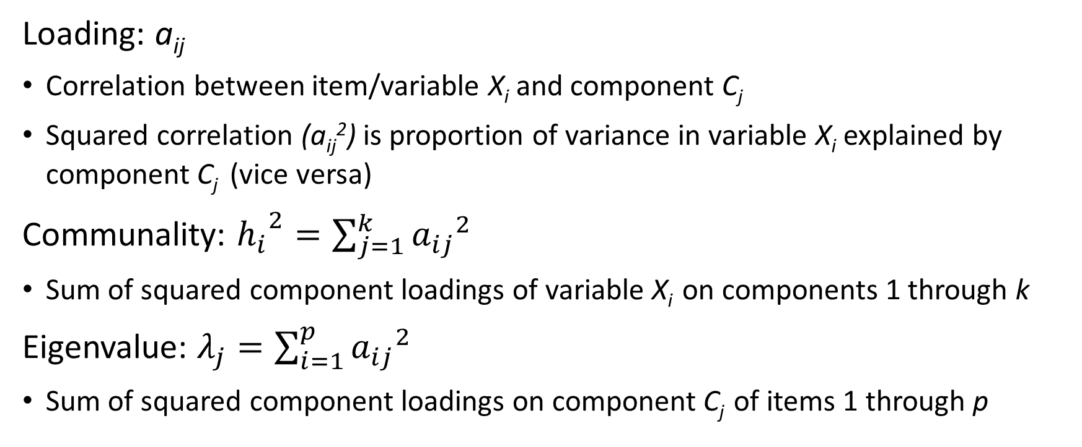
Loadings, communalities, eigenvalues
C₁
Loading: a_{ij}
Correlation between item/variable X_{i} and component C_{j}
Squared correlation (a_{ij}²) is proportion of variance in variable X_{i} explained by component C_{j} (vice versa)
Communality: ${h_{i}}^{2}=\sum_{j=1}^{k}{{a_{ij}}^{2}}$
Sum of squared component loadings of variable X_{i} on components 1 through k
Eigenvalue: $λ_{j}=\sum_{i=1}^{p}{{a_{ij}}^{2}}$
Sum of squared component loadings on component C_{j} of items 1 through p
a₁₁ a₂₁ a₃₁ a₄₁
X1
X2
X3
X4

Slide 19
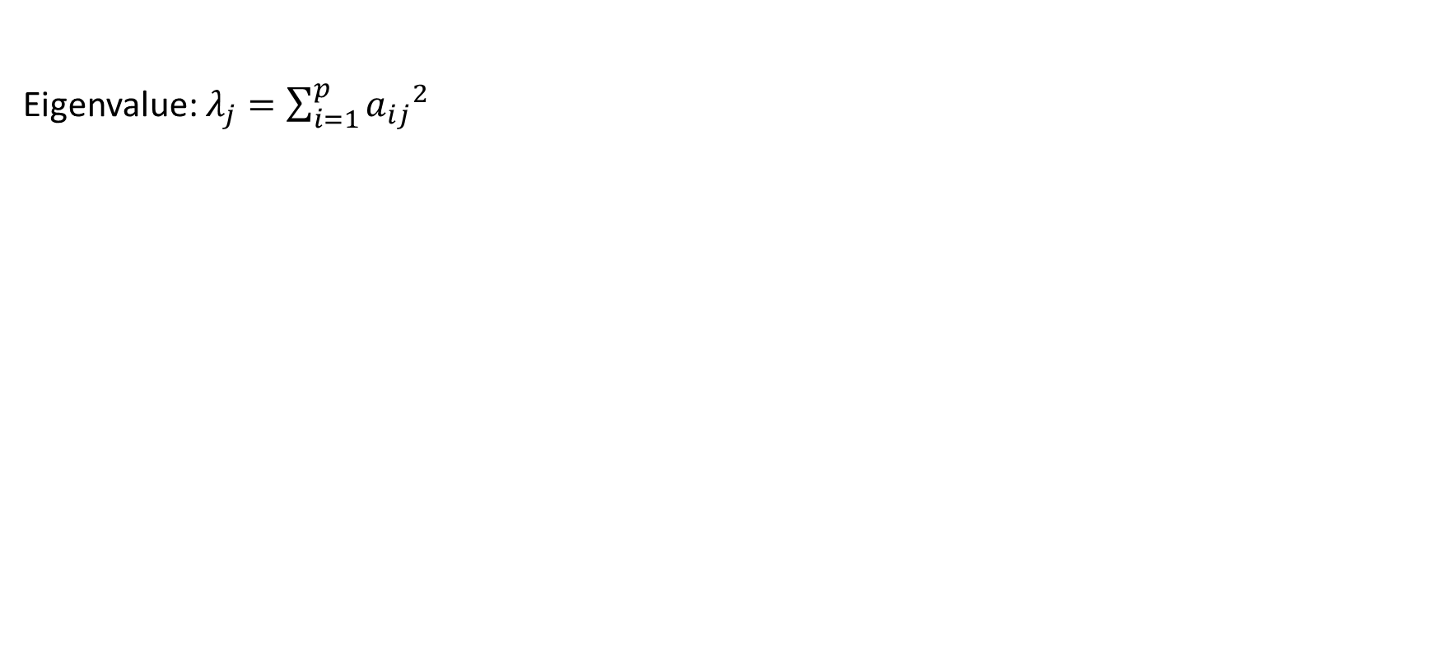
Loadings, communalities & eigenvalues
Eigenvalue: $λ_{j}=\sum_{i=1}^{p}{{a_{ij}}^{2}}$
Item C₁ C₂ C₁² C₂² h²
X₁ .859 -.317 .738 .100 .838
X₂ .813 -.353 .661 .125 .786
X₃ .802 -.248 .643 .062 .705
X₄ .767 .450 .588 .203 .791
X₅ .705 .586 .497 .343 .840

Slide 20
Loadings, communalities & eigenvalues
Eigenvalue: $λ_{j}=\sum_{i=1}^{p}{{a_{ij}}^{2}}$
Item C₁ C₂ C₁² C₂² h²
X₁ .859 -.317 .738 .100 .838
X₂ .813 -.353 .661 .125 .786
X₃ .802 -.248 .643 .062 .705
X₄ .767 .450 .588 .203 .791
X₅ .705 .586 .497 .343 .840
∑ 3.127 .832 3.959
prop. item variance explained .626 .166 .792

Slide 21
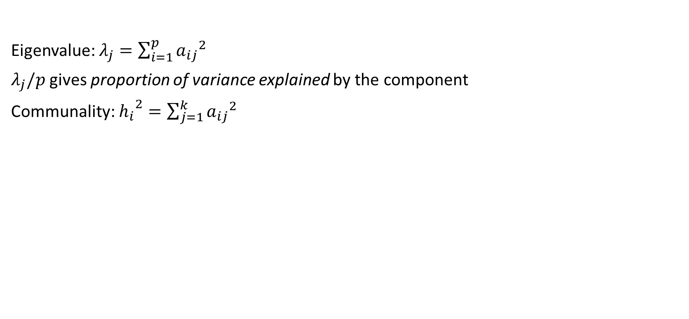
Loadings, communalities & eigenvalues
Eigenvalue: $λ_{j}=\sum_{i=1}^{p}{{a_{ij}}^{2}}$
$λ_{j}/p$ gives proportion of variance explained by the component
Communality: ${h_{i}}^{2}=\sum_{j=1}^{k}{{a_{ij}}^{2}}$
Item C₁ C₂ C₁² C₂² h²
X₁ .859 -.317 .738 .100 .838
X₂ .813 -.353 .661 .125 .786
X₃ .802 -.248 .643 .062 .705
X₄ .767 .450 .588 .203 .791
X₅ .705 .586 .497 .343 .840
∑ 3.127 .832 3.959
prop. item variance explained .626 .166 .792

Slide 22
Loadings, communalities & eigenvalues
Eigenvalue: $λ_{j}=\sum_{i=1}^{p}{{a_{ij}}^{2}}$
$λ_{j}/p$ gives proportion of variance explained by the component
Communality: ${h_{i}}^{2}=\sum_{j=1}^{k}{{a_{ij}}^{2}}$
Item C₁ C₂ C₁² C₂² h²
X₁ .859 -.317 .738 .100 .838
X₂ .813 -.353 .661 .125 .786
X₃ .802 -.248 .643 .062 .705
X₄ .767 .450 .588 .203 .791
X₅ .705 .586 .497 .343 .840
∑ 3.127 .832 3.959
prop. item variance explained .626 .166 .792

Slide 23
Loadings, communalities & eigenvalues
Eigenvalue: $λ_{j}=\sum_{i=1}^{p}{{a_{ij}}^{2}}$
$λ_{j}/p$ gives proportion of variance explained by the component
Communality: ${h_{i}}^{2}=\sum_{j=1}^{k}{{a_{ij}}^{2}}$
Item C₁ C₂ C₁² C₂² h²
X₁ .859 -.317 .738 .100 .838
X₂ .813 -.353 .661 .125 .786
X₃ .802 -.248 .643 .062 .705
X₄ .767 .450 .588 .203 .791
X₅ .705 .586 .497 .343 .840
∑ 3.127 .832 3.959
prop. item variance explained .626 .166 .792

Slide 24
Example: PCA on the Big-Five International Personality Item Pool
50 items, 5-point Likert scale (1=Disagree, 3=Neutral, 5=Agree)
N = 19,718 respondents
Example items:
E1. I am the life of the party. (Extraversion, + keyed) E2. I don't talk a lot. (Extraversion, - keyed)
N1. I get stressed out easily. (Neuroticism, + keyed) N2. I am relaxed most of the time. (Neuroticism, - keyed)
A1. I feel little concern for others. (Agreeableness, - keyed) A2. I am interested in people. (Agreeableness, + keyed)
C1. I am always prepared. (Conscientiousness, + keyed) C2. I leave my belongings around. (Conscientiousness, -keyed)
O1. I have a rich vocabulary. (Openness, + keyed) O2. I have difficulty understanding abstract ideas. (Openness, - keyed)

Slide 25

Correlation matrix (most items omitted for readability)
E1 E2 N1 N2 A1 A2 C1 C2 O1 O2
E1 1.000 -0.421 -0.114 0.151 -0.015 0.272 0.055 0.036 0.040 -0.025
E2 -0.421 1.000 0.061 -0.030 0.123 -0.274 -0.012 -0.046 -0.055 0.058
N1 -0.114 0.061 1.000 -0.465 -0.001 -0.045 -0.085 0.091 -0.046 0.174
N2 0.151 -0.030 -0.465 1.000 0.023 0.116 0.085 0.031 0.039 -0.076
A1 -0.015 0.123 -0.001 0.023 1.000 -0.231 -0.028 -0.009 -0.105 0.117
A2 0.272 -0.274 -0.045 0.116 -0.231 1.000 0.067 0.067 0.075 -0.055
C1 0.055 -0.012 -0.085 0.085 -0.028 0.067 1.000 -0.260 0.129 -0.071
C2 0.036 -0.046 0.091 0.031 -0.009 0.067 -0.260 1.000 0.069 0.003
O1 0.040 -0.055 -0.046 0.039 -0.105 0.075 0.129 0.069 1.000 -0.328
O2 -0.025 0.058 0.174 -0.076 0.117 -0.055 -0.071 0.003 -0.328 1.000

Slide 26
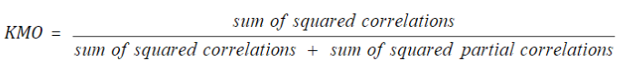

Kaiser–Meyer–Olkin criterion
r_{jk} is the correlation between variables j and k
p_{jk} is the partial correlation between variables j and k
Correlation between variables j and k, corrected for the effects of all other variables
The stronger the correlations between all variables in the dataset, the higher r_{jk} and the lower p_{jk}

Slide 27
Big-Five International Personality Item Pool
Opinions vary on how high KMO should be, rules of thumb:
Value between 0.8 and 1: adequate
KMO values less than 0.6 or 0.5: inadequate
Bartlett’s test: Tests whether all items are correlated 0 (this H₀ is rejected here).

Slide 28
> KMO(data)
Kaiser-Meyer-Olkin factor adequacy
Call: KMO(r = data)
Overall MSA = 0.91
MSA for each item =
E1 E2 E3 E4 E5 E6 E7 E8 E9 E10
0.94 0.93 0.96 0.95 0.95 0.94 0.94 0.90 0.92 0.95
N1 N2 N3 N4 N5 N6 N7 N8 N9 N10
0.93 0.91 0.92 0.90 0.96 0.93 0.87 0.87 0.93 0.94
A1 A2 A3 A4 A5 A6 A7 A8 A9 A10
0.91 0.94 0.90 0.89 0.92 0.90 0.91 0.95 0.90 0.96
C1 C2 C3 C4 C5 C6 C7 C8 C9 C10
0.92 0.86 0.90 0.94 0.91 0.88 0.89 0.94 0.89 0.91
O1 O2 O3 O4 O5 O6 O7 O8 O9 O10
0.77 0.84 0.81 0.81 0.86 0.83 0.91 0.75 0.90 0.85

Slide 29
> cortest.bartlett(cor(data), n = nrow(data))
$chisq[1] 376656.9
$p.value[1] 0
$df[1] 1225

Slide 30
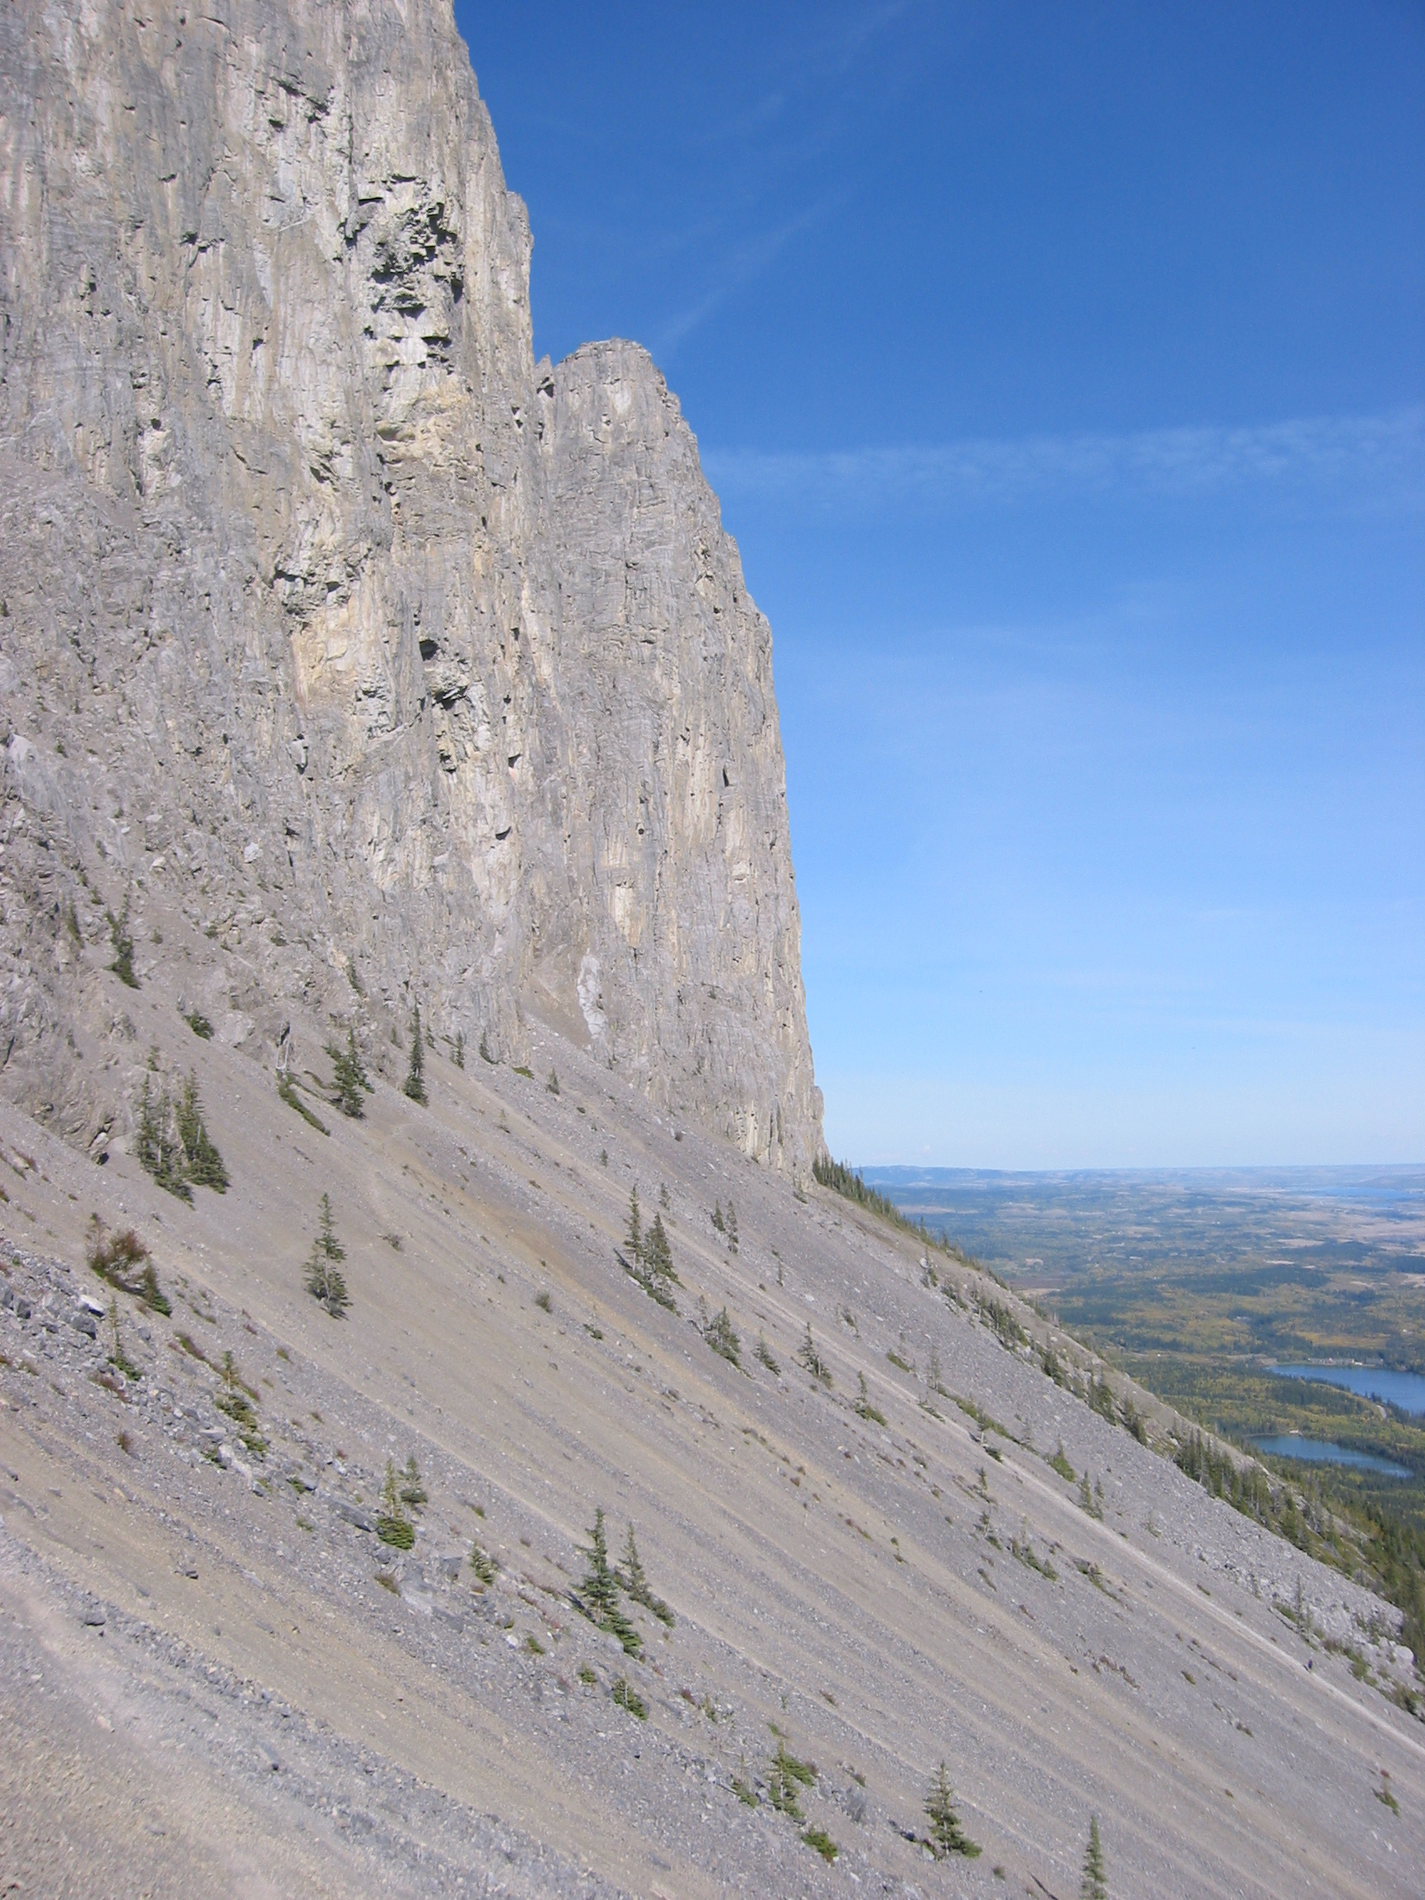
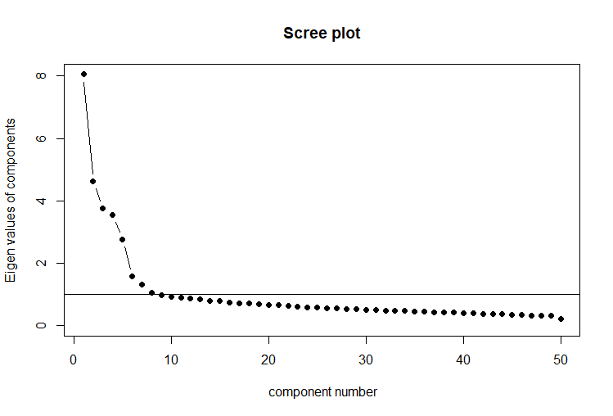
How many components to retain?
“I am just scree, please let me be”

Slide 31
How many components to retain?
Three criteria:
Retain all components with eigenvalue > 1
Elbow criterion: At the ‘elbow’, the amount of variance explained changes suddenly. The number of components just before the elbow likely results in simplest solution which explains most of the variance.
Choose solution that is easiest to interpret.
Often, multiple criteria are used. E.g.,
Use criterion 1. for a first rough distinction between “possibly relevant” and “certainly not relevant” components.
Use criterion 2. to further reduce the number of components to retain.
Interpret solutions at the elbow ±1 component to see which one is most useful.

Slide 32
Big-Five International Personality Item Pool
In practice, elbow criterion is often a bit unclear.
Interpreting one solution is already a lot of work, so we would like to eliminate as many solutions as possible before we start interpreting.
Should we interpret 3 (±1), 6 (±1) or 8 (±1) component solutions? Opinions may vary.

Slide 33
> pca1 <- principal(data, nfactors = 5, rotate = "none")
> pca1
Principal Components Analysis
Call: principal(r = data, nfactors = 5, rotate = "none")
Standardized loadings (pattern matrix) based upon correlation matrix
PC1 PC2 PC3 PC4 PC5 h2 u2 com
E1 -0.52 0.28 -0.29 -0.14 0.25 0.51 0.49 2.9
E2 0.51 -0.36 0.27 0.14 -0.22 0.53 0.47 3.0
E3 -0.71 0.16 -0.11 -0.22 0.11 0.60 0.40 1.4
E4 0.58 -0.21 0.31 0.18 -0.23 0.56 0.44 2.4
E5 -0.66 0.32 -0.16 -0.13 0.22 0.62 0.38 1.9
E6 0.56 -0.27 0.20 -0.06 -0.12 0.45 0.55 1.9
E7 -0.63 0.29 -0.23 -0.17 0.21 0.61 0.39 2.2
E8 0.38 -0.23 0.36 0.12 -0.24 0.40 0.60 3.6
E9 -0.47 0.25 -0.34 -0.04 0.26 0.46 0.54 3.1
E10 0.57 -0.16 0.30 0.16 -0.19 0.50 0.50 2.1
Strong negative loadings: Probably this item is reverse coded or reverse keyed compared to the items with strong positive loadings

Slide 34
N1 0.44 0.49 0.25 0.03 0.23 0.55 0.45 3.0
N2 -0.37 -0.31 -0.20 -0.03 -0.24 0.33 0.67 3.4
N3 0.35 0.46 0.35 0.08 0.17 0.49 0.51 3.2
N4 -0.29 -0.25 -0.10 -0.13 0.00 0.17 0.83 2.6
N5 0.41 0.41 0.08 -0.06 0.20 0.38 0.62 2.6
N6 0.47 0.54 0.17 0.00 0.25 0.61 0.39 2.6
N7 0.46 0.53 0.02 0.08 0.27 0.57 0.43 2.5
N8 0.49 0.54 0.02 0.07 0.27 0.61 0.39 2.5
N9 0.50 0.42 0.05 0.09 0.38 0.58 0.42 2.9
N10 0.55 0.40 0.12 0.17 0.09 0.51 0.49 2.2
A1 0.26 -0.18 -0.27 0.00 0.30 0.27 0.73 3.6
A2 -0.51 0.38 0.15 -0.09 -0.18 0.46 0.54 2.5
A3 0.28 0.11 -0.40 0.14 0.28 0.35 0.65 3.2
A4 -0.32 0.41 0.49 -0.11 -0.35 0.65 0.35 3.7
A5 0.38 -0.37 -0.34 0.12 0.33 0.52 0.48 4.2

Slide 35
A6 -0.16 0.38 0.45 -0.15 -0.24 0.45 0.55 3.1
A7 0.53 -0.36 -0.22 0.14 0.26 0.55 0.45 2.9
A8 -0.38 0.30 0.37 -0.08 -0.24 0.43 0.57 3.7
A9 -0.34 0.44 0.44 -0.06 -0.24 0.56 0.44 3.5
A10 -0.53 0.20 0.15 -0.05 -0.04 0.35 0.65 1.5
A6 -0.16 0.38 0.45 -0.15 -0.24 0.45 0.55 3.1
A7 0.53 -0.36 -0.22 0.14 0.26 0.55 0.45 2.9
A8 -0.38 0.30 0.37 -0.08 -0.24 0.43 0.57 3.7
A9 -0.34 0.44 0.44 -0.06 -0.24 0.56 0.44 3.5
A10 -0.53 0.20 0.15 -0.05 -0.04 0.35 0.65 1.5
C1 -0.31 -0.27 0.36 0.17 0.35 0.45 0.55 4.3
C2 0.14 0.35 -0.36 0.06 -0.33 0.38 0.62 3.4
C3 -0.21 -0.09 0.34 0.33 0.19 0.31 0.69 3.4
C4 0.43 0.43 -0.29 0.01 -0.19 0.50 0.50 3.1
C5 -0.31 -0.25 0.41 -0.05 0.39 0.48 0.52 3.6

Slide 36
C6 0.26 0.36 -0.37 0.01 -0.32 0.44 0.56 3.8
C7 -0.13 -0.15 0.44 0.12 0.37 0.38 0.62 2.6
C8 0.39 0.24 -0.35 -0.03 -0.15 0.36 0.64 3.0
C9 -0.26 -0.16 0.47 0.01 0.41 0.48 0.52 2.8
C10 -0.27 -0.12 0.33 0.28 0.28 0.35 0.65 4.2
O1 -0.20 0.03 -0.09 0.62 -0.03 0.43 0.57 1.3
O2 0.28 0.06 0.10 -0.55 0.19 0.43 0.57 1.9
O3 -0.10 0.23 -0.07 0.54 -0.09 0.37 0.63 1.5
O4 0.21 -0.05 0.05 -0.47 0.25 0.34 0.66 2.0
O5 -0.37 0.05 -0.08 0.56 0.12 0.47 0.53 1.9
O6 0.25 -0.13 0.09 -0.48 0.12 0.33 0.67 1.9
O7 -0.32 -0.08 0.00 0.51 0.05 0.36 0.64 1.8
O8 -0.04 0.10 -0.15 0.61 0.00 0.40 0.60 1.2
O9 0.01 0.19 0.23 0.41 -0.11 0.26 0.74 2.3
O10 -0.33 0.15 -0.12 0.62 0.01 0.53 0.47 1.8

Slide 37
PC1 PC2 PC3 PC4 PC5
SS loadings 8.05 4.62 3.75 3.55 2.76
Proportion Var 0.16 0.09 0.07 0.07 0.06
Cumulative Var 0.16 0.25 0.33 0.40 0.45
Proportion Explained 0.35 0.20 0.16 0.16 0.12
Cumulative Proportion 0.35 0.56 0.72 0.88 1.00
Mean item complexity = 2.7
Test of the hypothesis that 5 components are sufficient.
The root mean square of the residuals (RMSR) is 0.04 with the empirical chi square 85437.96 with prob < 0
Fit based upon off diagonal values = 0.95
How much variance explained is enough?
A high enough proportion of variance explained, using a low enough number of components.
Opinions may vary on how big a proportion this should be.

Slide 38
Rotation
A PCA solution is not unique.
Components (coordinate axes) of given solution can be rotated in an infinite number of ways, while it explaining the exact same variation in the variables / items.
For interpretation, we like a ‘simple structure’: All coefficient loadings as close as possible to 0 or (-)1.
Each item correlated strongly to one component, and not or weakly to other components.
Initially extracted components maximize eigenvalue of the first PC, then the 2nd, then the 3rd, etc.
Often does not provide simple structure.
Simple structure can often be obtained through rotation.
VARIMAX: Maximizes the sum of the variances of the squared loadings (squared correlations between variables and factors). Components remain independent (orthogonal).
OBLIMIN: Similar aim, but components do not remain independent (oblique).

Slide 39
Unrotated
Component 2
X₅
Item C₁ C₂
X₁ .859 -.317
X₂ .813 -.353
X₃ .802 -.248
X₄ .767 .450
X₅ .705 .586
X₄
Component 1
X₃
No simple structure
X₁
X₂

Slide 40
Rotated
Oblimin (oblique) Varimax (orthogonal)
Component 2
Component 2
X₅
X₅
X₄
X₄
Component 1
Component 1
X₃
X₃
X₁
X₁
X₂
X₂
Simple structure!
No simple structure

Slide 41
> pca2 <- principal(data, nfactors = 5, rotate = "oblimin")
> pca2
Principal Components Analysis
Call: principal(r = data, nfactors = 5, rotate = "oblimin")
Standardized loadings (pattern matrix) based upon correlation matrix
TC1 TC2 TC5 TC3 TC4 h2 u2 com
E1 0.73 0.04 -0.02 0.00 0.00 0.51 0.49 1.0
E2 -0.73 -0.09 -0.05 0.04 0.00 0.53 0.47 1.0
E3 0.65 -0.18 0.18 0.09 -0.06 0.60 0.40 1.4
E4 -0.75 0.06 0.03 0.00 0.03 0.56 0.44 1.0
E5 0.74 0.02 0.13 0.07 0.03 0.62 0.38 1.1
E6 -0.58 0.02 -0.09 0.00 -0.20 0.45 0.55 1.3
E7 0.76 -0.01 0.08 0.02 -0.01 0.61 0.39 1.0
E8 -0.65 -0.05 0.12 0.07 0.00 0.40 0.60 1.1
E9 0.69 0.05 -0.10 -0.02 0.09 0.46 0.54 1.1
E10 -0.69 0.11 0.02 0.00 0.02 0.50 0.50 1.1

Slide 42
N1 -0.06 0.73 0.10 0.05 -0.05 0.55 0.45 1.1
N2 0.07 -0.56 -0.01 -0.11 0.05 0.33 0.67 1.1
N3 -0.12 0.66 0.21 0.11 0.01 0.49 0.51 1.3
N4 0.15 -0.34 -0.08 0.08 -0.09 0.17 0.83 1.7
N5 0.02 0.59 0.01 -0.05 -0.12 0.38 0.62 1.1
N6 0.00 0.77 0.07 -0.01 -0.07 0.61 0.39 1.0
N7 0.07 0.74 -0.05 -0.08 0.02 0.57 0.43 1.1
N8 0.06 0.76 -0.06 -0.09 0.01 0.61 0.39 1.0
N9 0.04 0.76 -0.16 0.04 0.00 0.58 0.42 1.1
N10 -0.21 0.62 0.02 -0.11 0.09 0.51 0.49 1.4
A1 0.07 0.10 -0.51 0.03 -0.08 0.27 0.73 1.2
A2 0.30 -0.04 0.54 -0.05 0.06 0.46 0.54 1.6
A3 0.20 0.30 -0.47 -0.15 0.11 0.35 0.65 2.5
A4 -0.05 0.04 0.81 0.00 -0.01 0.65 0.35 1.0
A5 -0.06 0.04 -0.71 0.06 0.00 0.52 0.48 1.0

Slide 43
A6 -0.06 0.14 0.67 0.01 -0.09 0.45 0.55 1.2
A7 -0.24 0.09 -0.64 0.05 -0.01 0.55 0.45 1.3
A8 0.05 -0.02 0.63 0.05 0.02 0.43 0.57 1.0
A9 0.04 0.11 0.73 0.03 0.04 0.56 0.44 1.1
A10 0.30 -0.08 0.37 0.12 0.06 0.35 0.65 2.3
C1 0.02 -0.03 -0.04 0.65 0.12 0.45 0.55 1.1
C2 0.06 0.05 0.09 -0.60 0.14 0.38 0.62 1.2
C3 -0.08 0.07 0.07 0.46 0.30 0.31 0.69 1.9
C4 -0.02 0.32 0.01 -0.56 0.03 0.50 0.50 1.6
C5 0.08 0.00 0.01 0.68 -0.10 0.48 0.52 1.1

Slide 44
C6 0.02 0.11 0.05 -0.64 0.07 0.44 0.56 1.1
C7 -0.06 0.16 0.00 0.63 0.05 0.38 0.62 1.2
C8 -0.01 0.18 -0.13 -0.50 -0.03 0.36 0.64 1.4
C9 0.05 0.12 0.05 0.69 -0.04 0.48 0.52 1.1
C10 0.00 0.07 0.02 0.53 0.26 0.35 0.65 1.5
O1 -0.02 -0.03 -0.05 0.02 0.66 0.43 0.57 1.0
O2 0.07 0.24 -0.02 0.05 -0.61 0.43 0.57 1.3
O3 -0.01 0.11 0.07 -0.11 0.59 0.37 0.63 1.2
O4 0.11 0.15 -0.14 0.13 -0.54 0.34 0.66 1.5
O5 0.18 -0.01 -0.07 0.15 0.62 0.47 0.53 1.3
O6 -0.04 0.05 -0.08 0.07 -0.55 0.33 0.67 1.1
O7 0.03 -0.11 -0.04 0.19 0.54 0.36 0.64 1.3
O8 -0.03 0.09 -0.13 -0.06 0.63 0.40 0.60 1.2
O9 -0.21 0.17 0.23 0.04 0.41 0.26 0.74 2.7
O10 0.15 0.02 0.00 0.02 0.69 0.53 0.47 1.1

Slide 45
Standardized loadings (pattern matrix) based upon correlation matrix
TC1 TC2 TC5 TC3 TC4
SSloadings 5.57 5.11 4.31 3.90 3.84
Proportion Var 0.11 0.10 0.09 0.08 0.08
Cumulative Var 0.11 0.21 0.30 0.38 0.45
Proportion Explained 0.25 0.22 0.19 0.17 0.17
Cumulative Proportion 0.25 0.47 0.66 0.83 1.00
With component correlations of
TC1 TC2 TC5 TC3 TC4
TC1 1.00 -0.21 0.22 0.07 0.14
TC2 -0.21 1.00 -0.04 -0.20 -0.06
TC5 0.22 -0.04 1.00 0.13 0.06
TC3 0.07 -0.20 0.13 1.00 0.04
TC4 0.14 -0.06 0.06 0.04 1.00

Slide 46
Standardized loadings (pattern matrix) based upon correlation matrix
TC1 TC2 TC5 TC3 TC4
SSloadings 5.57 5.11 4.31 3.90 3.84
Proportion Var 0.11 0.10 0.09 0.08 0.08
Cumulative Var 0.11 0.21 0.30 0.38 0.45
Proportion Explained 0.25 0.22 0.19 0.17 0.17
Cumulative Proportion 0.25 0.47 0.66 0.83 1.00
With component correlations of
TC1 TC2 TC5 TC3 TC4
TC1 1.00 -0.21 0.22 0.07 0.14
TC2 -0.21 1.00 -0.04 -0.20 -0.06
TC5 0.22 -0.04 1.00 0.13 0.06
TC3 0.07 -0.20 0.13 1.00 0.04
TC4 0.14 -0.06 0.06 0.04 1.00
Exact same variance explained before and after rotation!
Sum of squared loadings for each component changed, but the total sum of it is exactly the same.
Note that h² and u² (=1- h²) of items is also exactly the same.

